Slide 1

DR. BABASAHEB AMBEDKAR TECHNOLOGICAL UNIVERSITY,LONERE
DEPARTMENT: COMPUTER ENGINEERING
SUBJECTIVE ANSWER EVALUATION USING NLP
GUI DE : MR. SANIL GANDHI
MEMBERS:-
PRASAD MANE
SAURABH CHAWARE

Slide 2


CONTENT
01
02
03
04
05
INTRODUCTION
MOTIVATION AND CHALLENGES
PROBLEM STATEMENT AND OBJECTIVE
PROPOSED ARCHITECTURE
CONCLUSION

Slide 3






INTRODUCTION
Millions of students take some test. To evaluate that with humans is hard and requires lot of manpower.
To solve this problem, the system can use AI to auto- evaluate millions of papers in one go.

Slide 4

MOTIVATION AND CHALLENGES
To aid the educational sector in performing their other duties efficiently. To reduce the manual labor in trivial tasks such as comparing the answers with a correct solution.
Leads to teachers spending more time teaching students, preparing a better curriculum, and evaluating their tests with less human errors and more transparency.

Slide 5


PROBLEM STATEMENT
Auto-assign marks to Answers written by students

Slide 6

OBJECTIVES
Automate answer sheet evaluation Save teachers’ time
Focus on valuable aspects of education Establish standardised evaluation criteria
Develop algorithms that can handle diverse reasoning patterns, linguistic styles, and language proficiency levels

Slide 7




Technologies Used
Reactjs
Flask
ML
XMPP Server

Slide 8
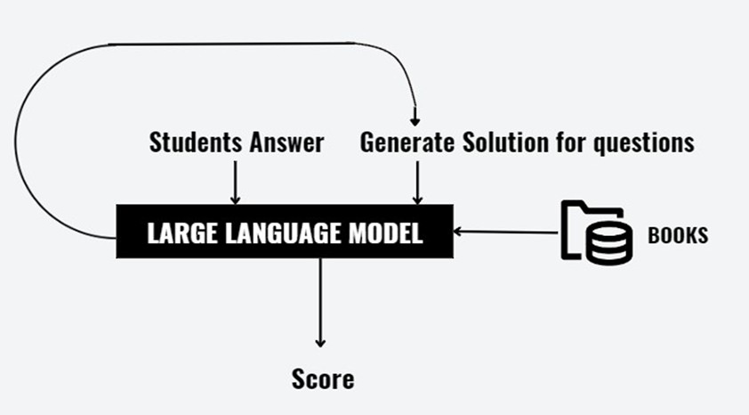
PROPOSED ARCHITECTURE

Slide 9
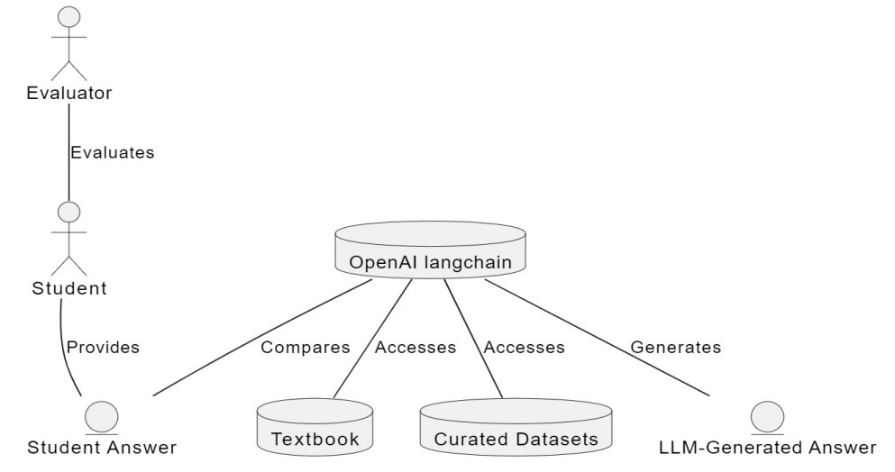
ENTITY RELATIONSHIP DIAGRAMS

Slide 10


Proposed Methodology
The idea is to use Langchain. I t will involve use of powerful transformer models such as GPT-3.
The system will use embeddings from LLM for calculating similarity which would be the score.

Slide 11
Applications
Automatically grade subjective answers of students
Reduce the workload of teachers and allow more focus on teaching and curriculum design.
Focus on valuable aspects of education Establish standardized evaluation criteria
Develop algorithms that can handle diverse reasoning patterns, linguistic styles, and language proficiency levels

Slide 12

Advantages
Automate answer sheet evaluation Save teachers’ time
Disadvantages
It is slow, hard, and not always fair.
It is not easy to compare and apply to different systems or models.

Slide 13
References
M. F. Bashir, H. Arshad, A. R. Javed, N. Kryvinska and S. S. Band, "Subjective Answers Evaluation Using Machine Learning and Natural Language Processing," in IEEE Access, vol. 9, pp. 158972-158983, 2021, doi: 10.1109/ACCESS.2021.3130902.
Kumari, T.S., Kumar, H., Ahmed, S., Sree, J. and Sravani, J., 2022. Evaluating Descriptive Answer Using Machine Learning And Natural Language Processing.
S. K. Sinha, S. Yadav, and B. Verma, "NLP-based Automatic Answer Evaluation,"
2022 6th International Conference on Computing Communication(ICCMC),Erode,India,2022,pp.807-811,doi: 10.1109/ICCMC53470.2022.9754052.
Methodologies and

Slide 14
References
https://docs.langchain.com/docs/
P. S. Devi, S. Sarkar, T. S. Singh, L. D. Sharma, C. Pankaj, and K. R. Singh, "An Approach to Evaluating Subjective Answers using BERT model," 2022 IEEE International Conference on Electronics, Computing and Communication Technologies (CONNECT), Bangalore, India, 2022, pp. 1-4, doi: 10.1109/CONECCT55679.2022.9865706.
Patil, P., Patil, S., Miniyar, V., & Bandal, A. (2018). Subjective Answer Evaluation Using Machine Learning. International Journal of Pure and Applied Mathematics, 23 May

Slide 15

CONCLUSION
The system can automate the task of evaluating answer sheets with the help of AI

